Slide 1
Parser
Parser is a compiler that is used to break the data into smaller elements coming from lexical analysis phase.
A parser takes input in the form of sequence of tokens and produces output in the form of parse tree.
Parsing is of two types: top down parsing and bottom up parsing.

Slide 2
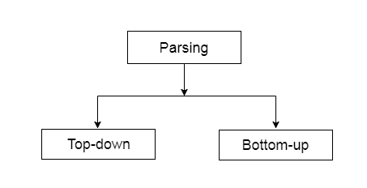
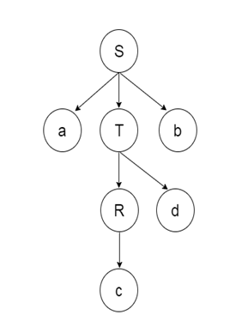
Top down parsing :
The top down parsing is known as recursive parsing or predictive parsing.
This is used to construct a parse tree for an input string.
In the top down parsing, the parsing starts from the start symbol and transform it into the input symbol.
Parse Tree representation of input string "acdb" is as follows:

Slide 3
Bottom up parsing
Bottom up parsing is also known as shift-reduce parsing.
Bottom up parsing is also used to construct a parse tree for an input string.
In the bottom up parsing, the parsing starts with the input symbol and construct the parse tree up to the start symbol by tracing out the rightmost derivations of string in reverse.

Slide 4
Example : Production
E → T
T → T * F
T → id
F → T
F → id
Parse Tree representation of input string "id * id" is as follows:

Slide 5
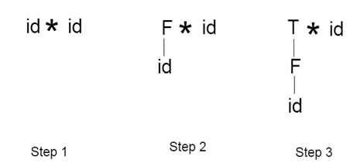
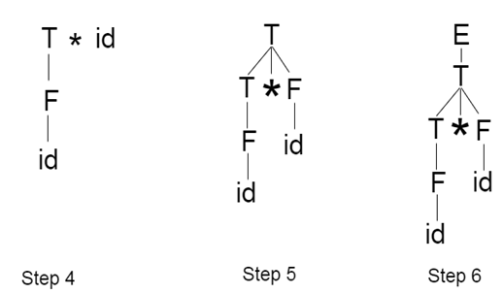

Slide 6
Bottom up parsing is classified into various parsing. These are as follows:
Shift-Reduce Parsing
Operator Precedence Parsing
Table Driven LR Parsing
LR( 1 )
SLR( 1 )
CLR ( 1 )
LALR( 1 )

Slide 7

Shift reduce parsing
Shift reduce parsing is a process of reducing a string to the start symbol of a grammar.
Shift reduce parsing uses a stack to hold the grammar and an input tape to hold the string.

Slide 8
Shift reduce parsing performs the two actions: shift and reduce. That's why it is known as shift reduce parsing.
At the shift action, the current symbol in the input string is pushed to a stack.
At each reduction, the symbols will replaced by the non-terminals. The symbol is the right side of the production and non-terminal is the left side of the production.

Slide 9
Example Grammar :
S → S+S
S → S-S
S → (S)
S → a
Input string: a1-(a2+a3)

Slide 10
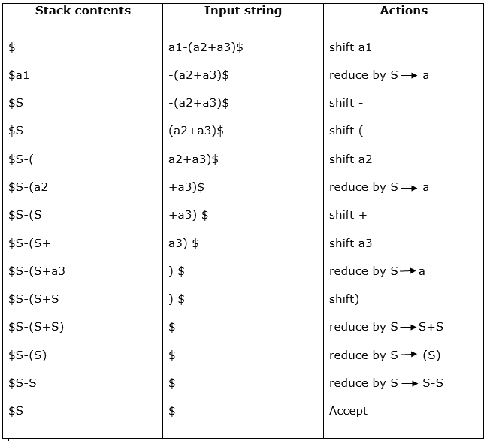
Parsing table:

Slide 11
There are two main categories of shift reduce parsing as follows:
Operator-Precedence Parsing
LR-Parser
Operator precedence parsing :
Operator precedence grammar is kinds of shift reduce parsing method. It is applied to a small class of operator grammars.
A grammar is said to be operator precedence grammar if it has two properties:
No R.H.S. of any production has a ∈.
No two non-terminals are adjacent.
Operator precedence can only established between the terminals of the grammar. It ignores the non-terminal.

Slide 12
There are the three operator precedence relations :
a ⋗ b means that terminal "a" has the higher precedence than terminal "b".
a ⋖ b means that terminal "a" has the lower precedence than terminal "b".
a ≐ b means that the terminal "a" and "b" both have same precedence.

Slide 13
Parsing Action
Both end of the given input string, add the $ symbol.
Now scan the input string from left , move right until the ⋗ is encountered.
Scan towards left over all the equal precedence until the first left most ⋖ is encountered.
Everything between left most ⋖ and right most ⋗ is a handle.
$ on $ means parsing is successful.

Slide 14
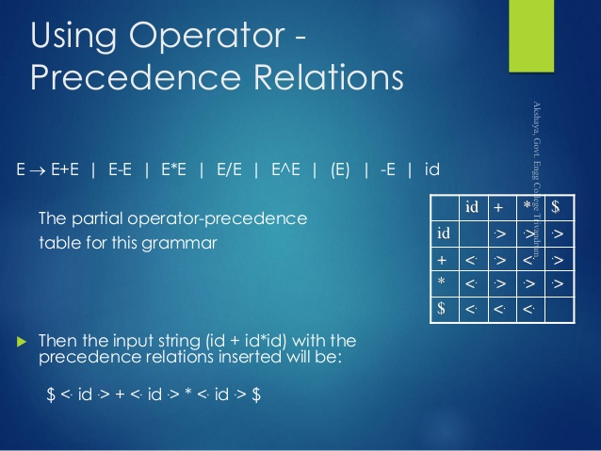

Slide 15
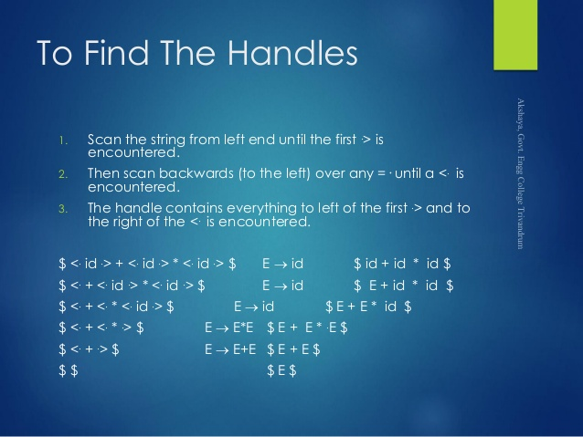

Slide 16
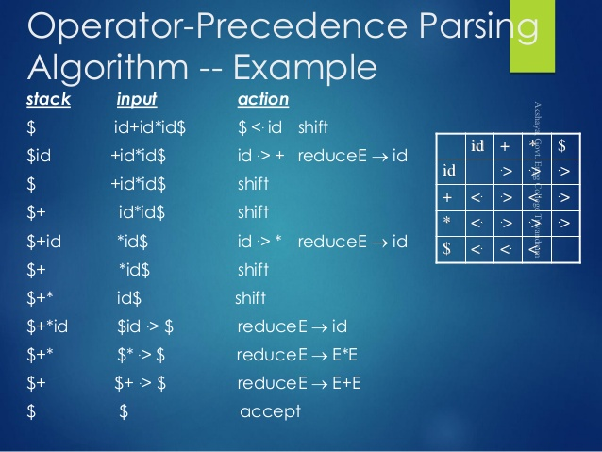

Slide 17
LR Parser
LR parsing is one type of bottom up parsing. It is used to parse the large class of grammars.
In the LR parsing, "L" stands for left-to-right scanning of the input.
"R" stands for constructing a right most derivation in reverse.
"K" is the number of input symbols of the look ahead used to make number of parsing decision.
LR parsing is divided into four parts: LR (0) parsing, SLR parsing, CLR parsing and LALR parsing.

Slide 18
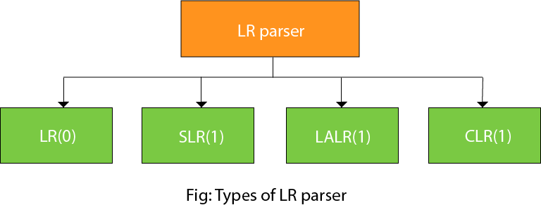

Slide 19
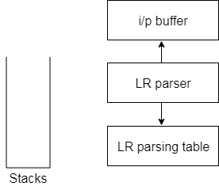
LR algorithm:
The LR algorithm requires stack, input, output and parsing table. In all type of LR parsing, input, output and stack are same but parsing table is different.

Slide 20
Input buffer is used to indicate end of input and it contains the string to be parsed followed by a $ Symbol.
A stack is used to contain a sequence of grammar symbols with a $ at the bottom of the stack.
Parsing table is a two dimensional array. It contains two parts: Action part and Go To part.

Slide 21
LR (1) Parsing
Various steps involved in the LR (1) Parsing:
For the given input string write a context free grammar.
Check the ambiguity of the grammar.
Add Augment production in the given grammar.
Create Canonical collection of LR (0) items.
Draw a data flow diagram (DFA).
Construct a LR (1) parsing table.

Slide 22
Augment Grammar
Augmented grammar G` will be generated if we add one more production in the given grammar G. It helps the parser to identify when to stop the parsing and announce the acceptance of the input.
Example
Given grammar S → AA
A → aA | b
The Augment grammar G` is represented by
S`→ S
S → AA
A → aA | b

Slide 23
Canonical Collection of LR(0) items
An LR (0) item is a production G with dot at some position on the right side of the production.
LR(0) items is useful to indicate that how much of the input has been scanned up to a given point in the process of parsing.
In the LR (0), we place the reduce node in the entire row.

Slide 24
Example
Given grammar:
S → AA
A → aA | b
Add Augment Production and insert '•' symbol at the first position for every production in G
S` → •S
S → •AA
A → •aA
A → •b

Slide 25
I0 State:
Add Augment production to the I0 State and Compute the Closure
I0 = Closure (S` → •S)
Add all productions starting with S in to I0 State because "•" is followed by the non-terminal. So, the I0 State becomes
I0 = S` → •S S → •AA
Add all productions starting with "A" in modified I0 State because "•" is followed by the non-terminal. So, the I0 State becomes.
I0= S` → •S S → •AA A → •aA A → •b

Slide 26
I1= Go to (I0, S) = closure (S` → S•) = S` → S•
Here, the Production is reduced so close the State.
I1= S` → S•
I2= Go to (I0, A) = closure (S → A•A)
Add all productions starting with A in to I2 State because "•" is followed by the non-terminal. So, the I2 State becomes
I2 =S→A•A A → •aA A → •b
Go to (I2,a) = Closure (A → a•A) = (same as I3)
Go to (I2, b) = Closure (A → b•) = (same as I4)

Slide 27
I3= Go to (I0,a) = Closure (A → a•A)
Add productions starting with A in I3.
A → a•A A → •aA A → •b
Go to (I3, a) = Closure (A → a•A) = (same as I3) Go to (I3, b) = Closure (A → b•) = (same as I4)
I4= Go to (I0, b) = closure (A → b•) = A → b• I5= Go to (I2, A) = Closure (S → AA•) = SA → A• I6= Go to (I3, A) = Closure (A → aA•) = A → aA•

Slide 28
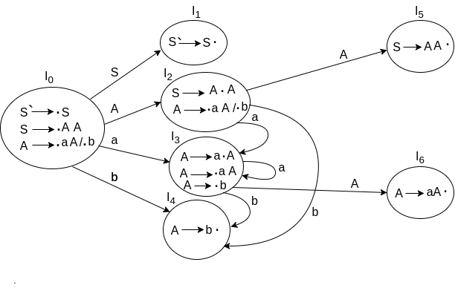
Drawing DFA

Slide 29
LR(0) Table
If a state is going to some other state on a terminal then it correspond to a shift move.
If a state is going to some other state on a variable then it correspond to go to move.
If a state contain the final item in the particular row then write the reduce node completely.

Slide 30
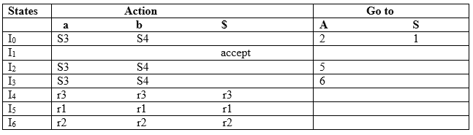

Slide 31
Explanation:
I0 on S is going to I1 so write it as 1.
I0 on A is going to I2 so write it as 2.
I2 on A is going to I5 so write it as 5.
I3 on A is going to I6 so write it as 6.
I0, I2and I3on a are going to I3 so write it as S3 which means that shift 3.
I0, I2 and I3 on b are going to I4 so write it as S4 which means that shift 4.
I4, I5 and I6 all states contains the final item because they contain • in the right most end. So rate the production as production number.

Slide 32
Productions are numbered as follows:
S → AA ... (1)
A → aA ... (2)
A → b ... (3)
I1 contains the final item which drives(S` → S•), so action {I1, $} = Accept.
I4 contains the final item which drives A → b• and that production corresponds to the production number 3 so write it as r3 in the entire row.
I5 contains the final item which drives S → AA• and that production corresponds to the production number 1 so write it as r1 in the entire row.
I6 contains the final item which drives A → aA• and that production corresponds to the production number 2 so write it as r2 in the entire row.

Slide 33
SLR (1) Parsing
SLR (1) refers to simple LR Parsing. It is same as LR(0) parsing. The only difference is in the parsing table.To construct SLR (1) parsing table, we use canonical collection of LR (0) item.
In the SLR (1) parsing, we place the reduce move only in the follow of left hand side.

Slide 34
Various steps involved in the SLR (1) Parsing:
For the given input string write a context free grammar
Check the ambiguity of the grammar
Add Augment production in the given grammar
Create Canonical collection of LR (0) items
Draw a data flow diagram (DFA)
Construct a SLR (1) parsing table

Slide 35
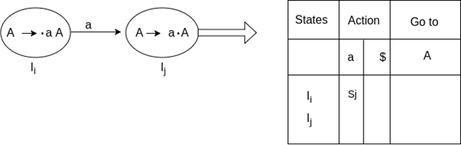
SLR (1) Table Construction
The steps which use to construct SLR (1) Table is given below:
If a state (I_{i}) is going to some other state (I_{j}) on a terminal then it corresponds to a shift move in the action part.

Slide 36
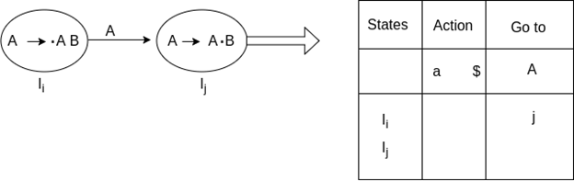
If a state (I_{i}) is going to some other state (I_{j}) on a variable then it correspond to go to move in the Go to part.

Slide 37
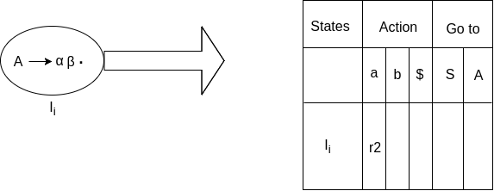
If a state (I_{i}) contains the final item like A → ab• which has no transitions to the next state then the production is known as reduce production. For all terminals X in FOLLOW (A), write the reduce entry along with their production numbers.
S -> •Aa
A->αβ•
Follow(S) = {$}
Follow (A) = {a}

Slide 38
SLR ( 1 ) Grammar E → E + T | T T → T * F | F F → id Add Augment Production and insert '•' symbol at the first position for every production in G S` → •E E → •E + T E → •T T → •T * F T → •F F → •id

Slide 39
I0 State:
Add Augment production to the I0 State and Compute the Closure
I0 = Closure (S` → •E)
Add all productions starting with E in to I0 State because "." is followed by the non-terminal. So, the I0 State becomes
I0 = S` → •E E → •E + T E → •T
Add all productions starting with T and F in modified I0 State because "." is followed by the non-terminal. So, the I0 State becomes.
I0= S` → •E E → •E + T E → •T T → •T * F T → •F F → •id

Slide 40
I1= Go to (I0, E) = closure (S` → E•, E → E• + T) I2= Go to (I0, T) = closure (E → T•T, T• → * F) I3= Go to (I0, F) = Closure ( T → F• ) = T → F• I4= Go to (I0, id) = closure ( F → id•) = F → id• I5= Go to (I1, +) = Closure (E → E +•T)
Add all productions starting with T and F in I5 State because "." is followed by the non-terminal. So, the I5 State becomes
I5 = E → E +•T T → •T * F T → •F F → •id
Go to (I5, F) = Closure (T → F•) = (same as I3) Go to (I5, id) = Closure (F → id•) = (same as I4)

Slide 41
I6= Go to (I2, *) = Closure (T → T * •F)
Add all productions starting with F in I6 State because "." is followed by the non-terminal. So, the I6 State becomes
I6 = T → T * •F F → •id
Go to (I6, id) = Closure (F → id•) = (same as I4)
I7= Go to (I5, T) = Closure (E → E + T•) = E → E + T• I8= Go to (I6, F) = Closure (T → T * F•) = T → T * F•

Slide 42
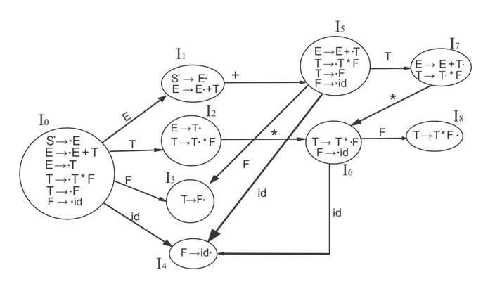
Drawing DFA

Slide 43
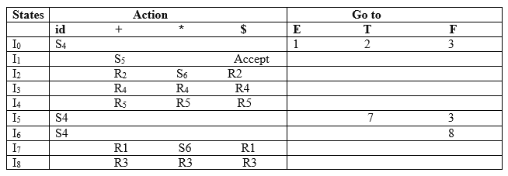
SLR (1) Table

Slide 44
Explanation
First (F) = {id} First (T) = {id} First (E) = {id} Follow (E) = {+, $} Follow (T) = {*, +, $} Follow (F) = {*, +, $}

Slide 45
I1 contains the final item which drives S → E• and follow (S) = {$}, so action {I1, $} = Accept
I2 contains the final item which drives E → T• and follow (E) = {+, $}, so action {I2, +} = R2, action {I2, $} = R2
I3 contains the final item which drives T → F• and follow (T) = {+, *, $}, so action {I3, +} = R4, action {I3, *} = R4, action {I3, $} = R4
I4 contains the final item which drives F → id• and follow (F) = {+, *, $}, so action {I4, +} = R5, action {I4, *} = R5, action {I4, $} = R5
I7 contains the final item which drives E → E + T• and follow (E) = {+, $}, so action {I7, +} = R1, action {I7, $} = R1
I8 contains the final item which drives T → T * F• and follow (T) = {+, *, $}, so action {I8, +} = R3, action {I8, *} = R3, action {I8, $} = R3.

Slide 46
CLR (1) Parsing
CLR refers to canonical lookahead. CLR parsing use the canonical collection of LR (1) items to build the CLR (1) parsing table. CLR (1) parsing table produces the more number of states as compare to the SLR (1) parsing.
In the CLR (1), we place the reduce node only in the lookahead symbols.

Slide 47
Various steps involved in the CLR (1) Parsing:
For the given input string write a context free grammar
Check the ambiguity of the grammar
Add Augment production in the given grammar
Create Canonical collection of LR (0) items
Draw a data flow diagram (DFA)
Construct a CLR (1) parsing table

Slide 48
LR (1) item
LR (1) item is a collection of LR (0) items and a look ahead symbol.
LR (1) item = LR (0) item + look ahead
The look ahead is used to determine that where we place the final item.
The look ahead always add $ symbol for the argument production.

Slide 49
Example
CLR ( 1 ) Grammar
S → AA
A → aA
A → b
Add Augment Production, insert '•' symbol at the first position for every production in G and also add the lookahead.
S` → •S, $
S → •AA, $
A → •aA, a/b
A → •b, a/b

Slide 50
I0 State:
Add Augment production to the I0 State and Compute the Closure
I0 = Closure (S` → •S)
Add all productions starting with S in to I0 State because "." is followed by the non-terminal. So, the I0 State becomes
I0 = S` → •S, $ S → •AA, $
Add all productions starting with A in modified I0 State because "." is followed by the non-terminal. So, the I0 State becomes.
I0= S` → •S, $ S → •AA, $ A → •aA, a/b A → •b, a/b

Slide 51
I1= Go to (I0, S) = closure (S` → S•, $) = S` → S•, $ I2= Go to (I0, A) = closure ( S → A•A, $ )
Add all productions starting with A in I2 State because "." is followed by the non-terminal. So, the I2 State becomes
I2= S → A•A, $ A → •aA, $ A → •b, $
I3= Go to (I0, a) = Closure ( A → a•A, a/b )
Add all productions starting with A in I3 State because "." is followed by the non-terminal. So, the I3 State becomes
I3= A → a•A, a/b A → •aA, a/b A → •b, a/b
Go to (I3, a) = Closure (A → a•A, a/b) = (same as I3) Go to (I3, b) = Closure (A → b•, a/b) = (same as I4)

Slide 52
I4= Go to (I0, b) = closure ( A → b•, a/b) = A → b•, a/b I5= Go to (I2, A) = Closure (S → AA•, $) =S → AA•, $ I6= Go to (I2, a) = Closure (A → a•A, $)
Add all productions starting with A in I6 State because "." is followed by the non-terminal. So, the I6 State becomes
I6 = A → a•A, $ A → •aA, $ A → •b, $
Go to (I6, a) = Closure (A → a•A, $) = (same as I6) Go to (I6, b) = Closure (A → b•, $) = (same as I7)
I7= Go to (I2, b) = Closure (A → b•, $) = A → b•, $ I8= Go to (I3, A) = Closure (A → aA•, a/b) = A → aA•, a/b I9= Go to (I6, A) = Closure (A → aA•, $) = A → aA•, $

Slide 53
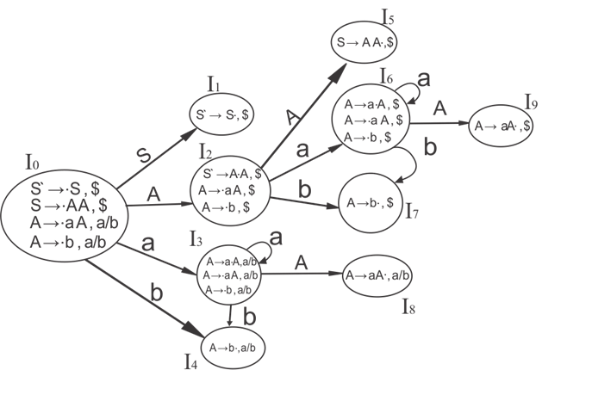
Drawing DFA

Slide 54
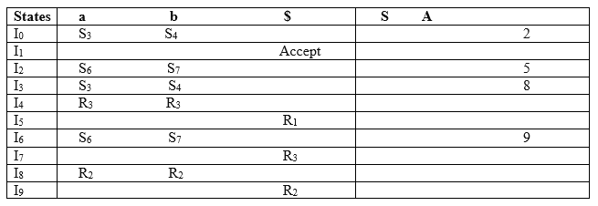
CLR (1) Parsing table

Slide 55
Productions are numbered as follows:
S → AA ... (1)
A → aA ... (2)
A → b ... (3)
The placement of shift node in CLR (1) parsing table is same as the SLR (1) parsing table. Only difference in the placement of reduce node.
I4 contains the final item which drives ( A → b•, a/b), so action {I4, a} = R3, action {I4, b} = R3. I5 contains the final item which drives ( S → AA•, $), so action {I5, $} = R1. I7 contains the final item which drives ( A → b•,$), so action {I7, $} = R3. I8 contains the final item which drives ( A → aA•, a/b), so action {I8, a} = R2, action {I8, b} = R2. I9 contains the final item which drives ( A → aA•, $), so action {I9, $} = R2.

Slide 56
LALR (1) Parsing
LALR refers to the lookahead LR. To construct the LALR (1) parsing table, we use the canonical collection of LR (1) items.
In the LALR (1) parsing, the LR (1) items which have same productions but different look ahead are combined to form a single set of items
LALR (1) parsing is same as the CLR (1) parsing, only difference in the parsing table.

Slide 57
Example LALR ( 1 ) Grammar
S → AA
A → aA
A → b
Add Augment Production, insert '•' symbol at the first position for every production in G and also add the look ahead.
S` → •S, $
S → •AA, $
A → •aA, a/b
A → •b, a/b

Slide 58
I0 State:
Add Augment production to the I0 State and Compute the ClosureL
I0 = Closure (S` → •S)
Add all productions starting with S in to I0 State because "•" is followed by the non-terminal. So, the I0 State becomes
I0 = S` → •S, $ S → •AA, $
Add all productions starting with A in modified I0 State because "•" is followed by the non-terminal. So, the I0 State becomes.
I0= S` → •S, $ S → •AA, $ A → •aA, a/b A → •b, a/b

Slide 59
I1= Go to (I0, S) = closure (S` → S•, $) = S` → S•, $ I2= Go to (I0, A) = closure ( S → A•A, $ )
Add all productions starting with A in I2 State because "•" is followed by the non-terminal. So, the I2 State becomes
I2= S → A•A, $ A → •aA, $ A → •b, $
I3= Go to (I0, a) = Closure ( A → a•A, a/b )
Add all productions starting with A in I3 State because "•" is followed by the non-terminal. So, the I3 State becomes
I3= A → a•A, a/b A → •aA, a/b A → •b, a/b
Go to (I3, a) = Closure (A → a•A, a/b) = (same as I3) Go to (I3, b) = Closure (A → b•, a/b) = (same as I4)

Slide 60
I4= Go to (I0, b) = closure ( A → b•, a/b) = A → b•, a/b I5= Go to (I2, A) = Closure (S → AA•, $) =S → AA•, $ I6= Go to (I2, a) = Closure (A → a•A, $)
Add all productions starting with A in I6 State because "•" is followed by the non-terminal. So, the I6 State becomes
I6 = A → a•A, $ A → •aA, $ A → •b, $
Go to (I6, a) = Closure (A → a•A, $) = (same as I6) Go to (I6, b) = Closure (A → b•, $) = (same as I7)
I7= Go to (I2, b) = Closure (A → b•, $) = A → b•, $ I8= Go to (I3, A) = Closure (A → aA•, a/b) = A → aA•, a/b I9= Go to (I6, A) = Closure (A → aA•, $) A → aA•, $

Slide 61
If we analyze then LR (0) items of I3 and I6 are same but they differ only in their lookahead.
I3 = { A → a•A, a/b A → •aA, a/b A → •b, a/b }
I6= { A → a•A, $ A → •aA, $ A → •b, $ }
Clearly I3 and I6 are same in their LR (0) items but differ in their lookahead, so we can combine them and called as I36.

Slide 62
I36 = { A → a•A, a/b/$ A → •aA, a/b/$ A → •b, a/b/$ }
The I4 and I7 are same but they differ only in their look ahead, so we can combine them and called as I47.
I47 = {A → b•, a/b/$}
The I8 and I9 are same but they differ only in their look ahead, so we can combine them and called as I89.
I89 = {A → aA•, a/b/$}

Slide 63
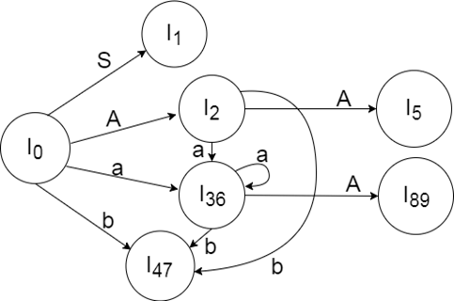
Drawing DFA:

Slide 64
States | a b $ | S A
I₀ | S₃₆ S₄₇ | 1 2
I₁ | accept
I₂ | S₃₆ S₄₇ | 5
I₃₆ | S₃₆ S₄₇ | 89
I₄₇ | R₃ R₃ R₃
I₅ | R₁
I₈₉ | R₂ R₂ R₂

Slide 65
Automatic Parser Generator
YACC is an automatic tool that generates the parser program.
YACC stands for Yet Another Compiler Compiler.
YACC provides a tool to produce a parser for a given grammar.
YACC is a program designed to compile a LALR (1) grammar.
It is used to produce the source code of the syntactic analyzer of the language produced by LALR (1) grammar.
The input of YACC is the rule or grammar and the output is a C program.
These are some points about YACC:
Input: A CFG- file.y
Output: A parser y.tab.c (yacc)

Slide 66
The output file "file.output" contains the parsing tables.
The file "file.tab.h" contains declarations.
The parser called the yyparse ().
Parser expects to use a function called yylex () to get tokens.

Slide 67
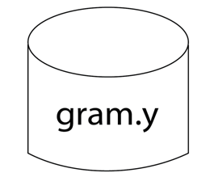
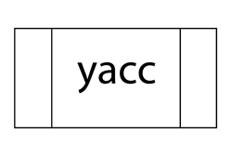

The basic operational sequence is as follows:
This file contains the desired grammar in YACC format.
It shows the YACC program.
It is the c source program created by YACC.

Slide 68
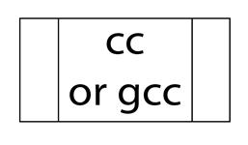
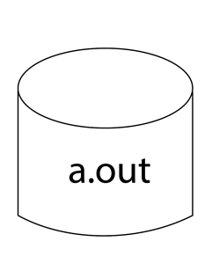
C Compiler
Executable file that will parse grammar given in gram.Y

